Slide 1
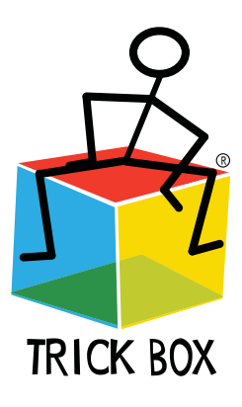

Slide 2
What is Trick Box?
Trick Box is a fun and effective personal development programme, to help children from Reception to Year 6 to:
Build confidence
Manage emotions and anxiety
Develop communication skills
Make positive actions
Coach themselves through challenges

Slide 3
What is Trick Box?
Each Friday children learn a new ‘Trick’ or practice some Tricks that they have already learnt.
Yellow Tricks will help you build confidence
Red Tricks will help you mange emotions and anxiety
Blue Tricks will help you develop communication skills and positive actions
Green Tricks will help you create and achieve personal goals

Slide 4
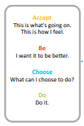
Letter Box Coaching Method
Accept
  This is what is going on and this is how I feel about it. Understanding and accepting ‘where we are’ is an important first step towards making positive change. Being able to label how we are feeling can be tricky so maybe you just feel ‘red’ or ‘blue’.

Slide 5
Letter Box Coaching Method
Accept
Be
  I want it to be better. We can’t control the world around us but we can choose to want to make our current situations better by learning to manage our own emotions, behaviour and communication. This will allow us to begin to positively influence our world.

Slide 6
Letter Box Coaching Method
Accept
Be
Choose
  What can I choose to do? We choose to manage our emotions, behaviour and communication but when we are stuck we need strategies. Trick Box will teach us lots of strategies which can be used alongside our own ideas.

Slide 7
Letter Box Coaching Method
Accept
Be
Choose
Do
  Do it! Committing to action and having the confidence to take steps to help ourselves is a key life skill.

Slide 8
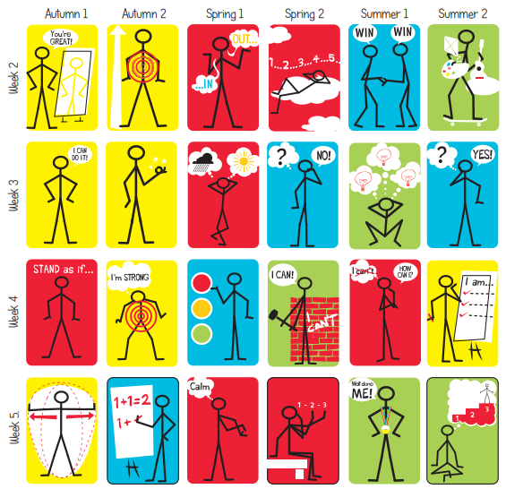

Slide 9

So…let’s try a Trick?
Red = manage emotions
Breathing colours

