Slide 1







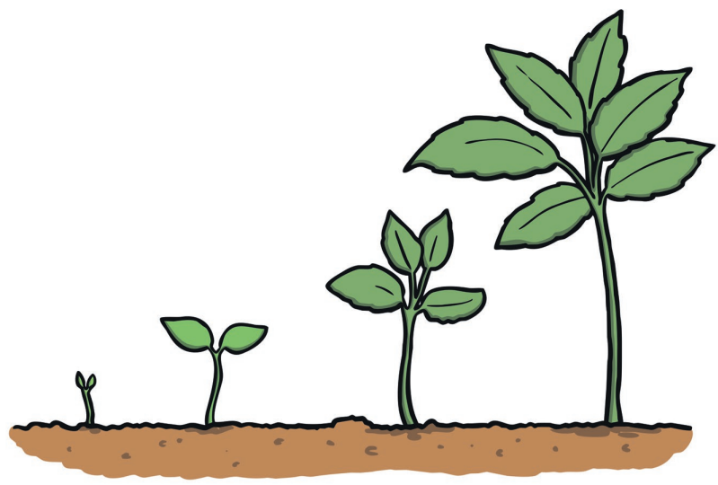
Our School Values
We have six values: Responsibility, Friendship, Respect, Resilience, Kindness and Honesty.
They underpin our practice, guiding how we deal with day to day life in a primary school.
Our place in our area and in the wider world | Enquiring mind | Language and Communication | Resilience, personal growth and well-being
We want our children to grow up with a secure knowledge and understanding of the local community, our national context and the wider world. Through a growing appreciation of different cultures and traditions, we want our children to develop respect and tolerance; we want them to embrace and celebrate diversity and know what it means to be a good citizen. We want our children to have an awareness of global issues, be good global citizens and take responsibility for the environment. We want to expose our children to experiences that they may not normally have and provide them with rich, broad and new opportunities. We recognise that trips and visiting speakers significantly enhance this aspect of the curriculum. | We encourage curiosity, love of learning and for the children to develop an enquiring mind. We want our children to be eager to learn and acquire new skills and knowledge, whilst being confident to ask for information and question ideas. This approach to learning enables inquisitive thinking such as exploration, investigation and problem solving. We want them to be lifelong learners. | Communication skills are vital for both success and confidence in many areas of life and therefore we want our children to develop the ability to express themselves clearly and effectively. We recognise that both listening and speaking are important when communicating and opportunities to practice and develop these skills are provided. We know that having a broad vocabulary aids both understanding of language and expression. Therefore, our curriculum is language – rich, involves use of high-quality texts, promotes an inquisitive approach to language and provides opportunities to practise new vocabulary. | Resilience means having the skills and resources to deal with challenges and set-backs. Our children will develop the emotional and physical security needed to become resilient individuals both in school and in the wider world. We have adopted the ‘Growth Mindset’ approach to learning. We want to promote well-being and personal growth to ensure children reach their full potential and develop their learning, social and emotional skills.

Slide 2
Curriculum Drivers
Phonics
Our place in our area and in the wider world | Enquiring mind | Language and Communication | Resilience, personal growth and well-being
To enable children to become part of our local area and the wider world they need to be able to read. Therefore our phonics programme is designed to ensure every child becomes a capable and fluent reader. We want every child to succeed in phonics and ensure children who are not ‘keeping up’ with the phonics programme are given rapid intervention enabling all children to become lifelong readers. We ensure that our reading books reflect a wide range of experiences and opportunities. | We want to inspire all children to develop a love of learning which explicitly links to learn to read as reading is crucial to acquiring more knowledge. By giving children a secure foundation in reading they are able to access all aspects of our broad and balanced curriculum enabling them to become inquisitive learners. We are learning to read and reading to learn. | Our phonics programme ‘Floppy’s Phonics’ has several links to language and communication. We have specifically chosen this programme as teaching vocabulary and expanding the children’s use and understanding of language is a key part of Floppy’s Phonics. The stories that the children have access to during phonics have a wide range of vocabulary which will support children’s development of language skills. Floppy’s Phonics has been designed to allow children regular opportunities to revise new vocabulary. | We aim for all children to become lifelong readers as we know this skill is crucial to personal growth. We ensure all children are given the tools to become resilient learners within all phonics lessons. Children are given opportunities to work independently, with an adult and in small focussed learning groups which enables children to develop their learning and social skills.

