Slide 1
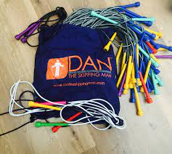
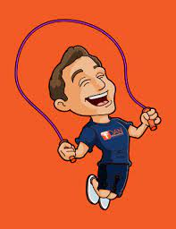
Sponsored Skipathon
Ellwood School will skip for 6 hours!
Ellwood School Council

Slide 2
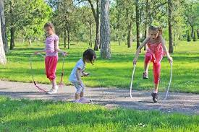
What is it?
On Friday 28th May, Ellwood School will hold a sponsored Skipathon where the school will be skipping for 6 hours!
During the Skipathon day, we will go out to the playground and classes will take it in turns to skip for about 15 – 20 minutes. There must always be someone on the playground skipping throughout the day!

Slide 3
Sponsorship
You will be given a sponsor form soon. You will need to take it home and ask family members or friends if they can sponsor you.
The money we raise will go towards and to a charity chosen by the school.

Slide 4
Why a Skipathon?
It has so many health benefits!
Skipping helps to burn more calories than running.
Skipping helps to develop fine and gross motor skills.
Skipping helps physical fitness.
Skipping helps keep our mind healthy too.
The tricks that you will learn will help with concentration and speed of thought.

Slide 5

Dan the Skipping Man!
To make sure that we are all ready for our sponsored Skipathon, we will be having a day of skipping workshops! A coach from Dan the Skipping Man will be coming in to play some fun games, teach us to skip and do tricks.
The coach will also be delivering a little treat to each child which will help you in the Skipathon… your own skipping rope!

Slide 6
The School Council need your help to decide which charity to raise money for.
As a class, think about types of charities we could raise money for.
Animal charities?
Children’s charities?
Health charities?
Are there any local charities you know of? Make sure you think about why that particular charity would be good to raise money for.
After your class discussion, the School Council representatives will write down your ideas.
They will bring your ideas to our next meeting and we will decide which charity we will raise some money for.

Slide 7
Next steps
In a couple of weeks, you will be given a sponsor sheet to take home. You will need to try and get as many friends and family members to sponsor as you can.
Once your skipping rope arrives, you will need to get practising! When you do the Daily Mile, why not take your skipping rope with you?

