Slide 1

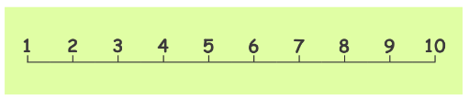

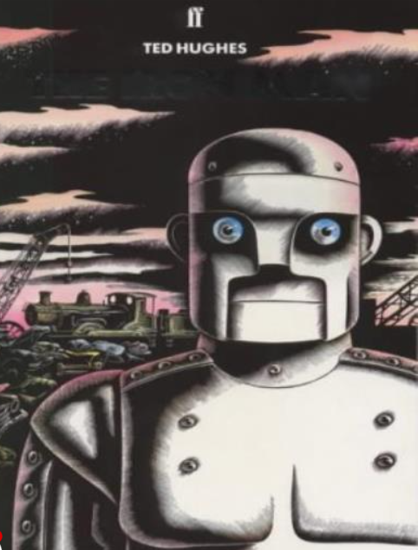
Ellwood Community Primary School – Core Subject Overview Year 3 – Autumn -Term 2
English | Maths | Science
This term we will be learning and reading the text Iron Man, by Ted Hughs. We will be reading our first chapter book of the term. We will be learning a range of grammatical Past tense Subordinate clauses Pronouns Vowel and consonants – recap Sufixes Prefixes Contractions Apostrophes |  | Light and Shadows They will learn about different sources of light, and that we need light to see. The children will work scientifically and collaboratively to investigate reflective materials, in the context of designing a new book bag. They will work in a hands on way to play a range of mirror games, finding out more about reflective surfaces. Furthermore, they will learn that the sun’s light can be dangerous, and will create an advert for a pair of sunglasses or a sun hat that they have designed. The children will have chance to test which objects are opaque in an exciting investigation to design the most effective curtains, and will find out how shadows change when the distance between the object and light source changes. They will develop their scientific enquiry skills, making observations, predictions and conclusions.
Addition and Subtraction:
Add and subtract numbers mentally, including:
a three-digit number and 1s
a three-digit number and 10s
a three-digit number and 100s
add and subtract numbers with up to 3 digits, using formal written methods of columnar addition and subtraction
estimate the answer to a calculation and use inverse operations to check answers
solve problems, including missing number problems, using number facts, place value, and more complex addition and subtraction
Multiplication and Division
Recap on adding equal groups, using arrays and the 2,5 and 10 times table
We will be learning to multiply by 3
Divide by 3
Learn all about the 3 times table
Grammar, Punctuation and Spelling

Slide 2

Ellwood Community Primary School – Specific Subject Overview Beech Class –Autumn 2
Computing Year 3- Pupils who are secure will be able to: Recognise that a network is two or more devices connected and its purpose. Identify key components that make up the school’s network. Explain the difference between wired and wireless connections. Recognise that files are saved on a server. Understand the role of the server in a network when requesting a website. Identify parts of a website’s journey to reach your computer. Recognise that routers connect to send information. Understand that data is broken into packets. Year 2- I understand what the terms ‘decomposition’ and ‘algorithm’ mean. To understand that computers can use algorithms to make predictions (machine learning). To plan algorithms that will solve problems To understand what abstraction is To understand what debugging is | Life Skills identify who the special people in their lives are and explain why they are important to them; • explain why having a family network is important; • know what makes someone a good friend and demonstrate these qualities; • put positive resolution techniques into practice; • cooperate with others to complete a task; • identify several ways to show others that they care and understand the importance of doing this | Modern Foreign Languages In a French Classroom. They will be able to listen to and respond to simple classroom discussions. They will be able to name the school items in a bag. The children will learn to answer questions in French. They will learn to speak, read and write short sentences about the classroom.
 | Geography – Where do I live? The children will use , atlases, globes and digital/computer mapping to locate countries and describe features studied. Use a compass during school grounds walk. Gather data – to put on graphs. Use OS maps to sketch walk. Take prt in fieldwork to observe, measure, record and present the human and physical features in the local area. |  | Art Sculpture, Abstract Shape and Space: During this unit the children will try out different ways to make card shapes three dimensional, e.g. folding and curving the card or joining the flat shapes together. Make a structure that holds its 3D shape. Explain in simple terms the difference between 2D and 3D art. Combine shapes together to make an interesting free-standing sculpture.
RE We will be exploring these two questions: Why is the Bible important to Christians today? What kind of world did Jesus want? | Music Great Composers: We will be learning about the Great Composer Stravinsky and we will be all members of the Year Three Choir for our Christmas Nativity 2024. |  | PE This term we will be learning ball skills and Dance. The children will be creating dances using choreography. To develop line dancing and create dances to a theme. To understand and use formation. In ball skills the children will learn to hit, roll and catch a ball. To develop dribbling a ball with his hands.

