Slide 1
How to recycle at home

Slide 2


Slide 3
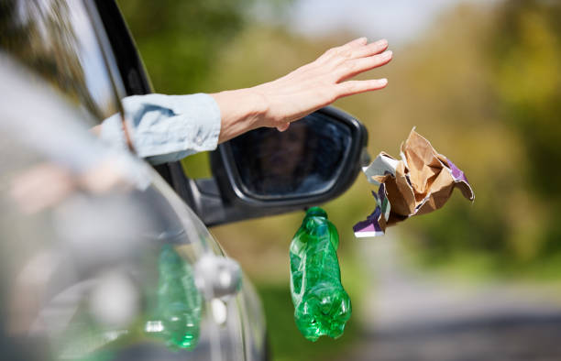
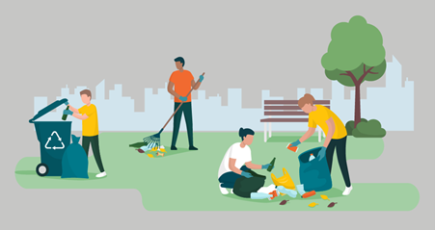
Plastic
There are ten types of pollution one of the ten is litter. If your out on a walk in the park or in the forest try and look out for some litter such as crisp packets or plastic bottles. You can’t just pick it up though because it could have bacteria on it.

Slide 4
How to get more in your recycling bin.
You can flatten boxes in the paper recycling bin. You could remove food and liquids from your food wrappers if they’re recyclable. Through your recycling in lose because if you put it in a plastic bag the bag cannot be recycled.

Slide 5


Thank you for listening!!!
Remember to recycle!

