Slide 1
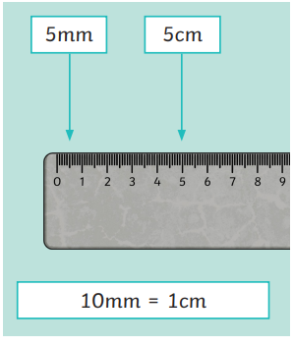


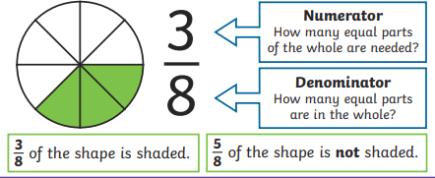
Ellwood Community Primary School – Core Subject Overview Year 3 – Spring Term 2
English | Maths | Science
Adventure Story – Excape from Pompeii This term we will be exploring the book ‘Escape from Pompeii’ by Christina Balit. We will begin with an exciting history hook. We will use the book to help us build our own stories. During this story unit we will learn to write and use prepositional phrases alongside expanded noun phrases. We will also look at the use of direct speech and inverted commas. We will recap upon the sentence types and a range of punctuation including, full stops, capital letters and commas. | Length and Perimeter In Maths, we will begin this term with learning about length and perimeter. We will be recapping on units of measure, meters, millimeters and centimeters. We will be measuring length and looking at equivalent lengths. In Maths, we will learn about perimeters of shapes. We will also learn to add and subtract lengths. Fractions In our unit of fractions we will begin by recognising a numerator and a denominator. We will then compare fraction and develop an understanding of equivalent fractions. We will learn to add and subtract fractions and read a fraction of an amount on a scales. | Animals Including Humans In this unit, Year Three will learning about the nutrients that different foods provide and how these nutrients help our bodies. They will also explore how different animals eat different types of foods and need different proportions of nutrients. Year Three will learn to understand what food labels on packaging show and gather information from food labels to help them to answer questions. In this unit, the children will also explore the different types of skeletons that animals have and compare these. They will learn some names of bones in the human body and carry out an investigation to explore if people with longer femurs jump further. They will discuss how to plan a fair test and measure and record accurately. Year Three will also learn about how muscles help us to move and make a simple scientific model which they use to explain to a partner how skeletal muscles work.
Newspaper Article
We will then end our unit with writing a newspaper article. The children will use the information from the book to write an article for a newspaper. We will be looking at ‘What makes a good newspaper article’ and working hard to include all of the elements in our own piece of writing. We look forward to sharing these with you.

Slide 2


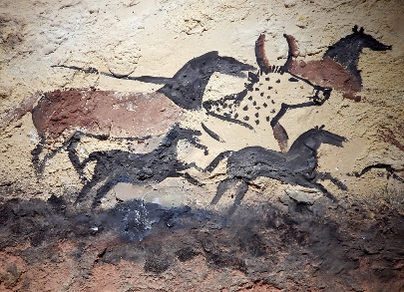


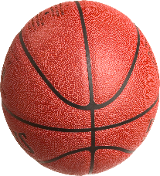


Ellwood Community Primary School – Specific Subject Overview Beech Class- Spring 2
Art In this unit, Beech Class will be learning about prehistoric art. The children will look at the patterns and outlines from prehistoric art. They will make their own paint and create a collaborative piece of art that we will be able to showcase with you. n this unit children learn about primary and secondary colours, colour mixing techniques, and applying these skills in painting and printing. | Life Skills This unit explores the book ‘The Outsiders’. We will look at the topic of discrimination and what this means. Beech Class will discuss what it is like to be an ‘outsider’ we will talk about how we can stop this from happening in our school. | Computing They will be learning about code and writing their own code to follow a sequence. Beech Class will learn basic programming vocabulary to make code upon the laptops.
 | Geography Hot and Cold In this unit of work children will learn about hot and cold countries in relation to the equator. We will explore the physical and human features of Brazil (a hot country) and Antarctic (a cold country). We will then compare both these places.
RE We will explore the question ‘What is prayer?’ During this topic we will learn how Christians, Hindus and Muslims pray and have a chance to reflect upon our own thoughts. | Music Beech Class will look at different soundscapes in relation to space and the world. They will focus on dynamics, pitch and pattern. | PE As part of our school P.E. curriculum Beech Class will receive Forest School Lessons each Friday. The Year 3s will also take part in swimming lessons every other Tuesday for a full hour. Beech Class will also learn invasion skills in basketball. They will understand what possession means and learn to attack and defended in a game of basketball.

