Slide 1

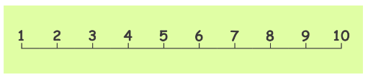

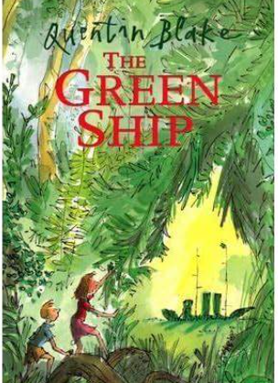
Ellwood Community Primary School – Core Subject Overview Year 3 – Spring 1
English | Maths | Science
This term we will be learning and reading the text The Green Ship by Quentin Blake. We will be immersing ourselves in the adventure story. We will be learning to write in the first person and looking at our tenses in our writing. We will firstly write a diary entry and then we will build up to writing our own adventure stories. Past tense Subordinate clauses Suffixes Prefixes Contractions Apostrophes Year 3 spelling rules |  | Light and Shadows They will learn about different sources of light, and that we need light to see. The children will work scientifically and collaboratively to investigate reflective materials, in the context of designing a new book bag. They will work in a hands on way to play a range of mirror games, finding out more about reflective surfaces. Furthermore, they will learn that the sun’s light can be dangerous, and will create an advert for a pair of sunglasses or a sun hat that they have designed. The children will have chance to test which objects are opaque in an exciting investigation to design the most effective curtains, and will find out how shadows change when the distance between the object and light source changes. They will develop their scientific enquiry skills, making observations, predictions and conclusions.
Multiplication and Division
Recap on adding equal groups, using arrays and the 2,5 and 10 times table
We will be learning to multiply by 3
Divide by 3
Learn all about the 3 times table
Multiply by 4
Divide by 4
Multiply 8
Divide by 8
The 2,4 and 8 times table
Multiples of 10
Related calculations
Reasoning about multiplication
Multiply by a 1 digit number with and without exchange
Link multiplication with division
Divide a two digit by 1 digit number with and without remainders
Grammar, Punctuation and Spelling

Slide 2

Ellwood Community Primary School – Specific Subject Overview Beech Class –Spring 1
History – Famous Explorers We will begin with look at what makes a significant individual. Then we will learn all about the following famous explorers; Ibm Battua, Scott of the Antartic, Ann Vancroft and Ranulph Fiennes. Whilst learning about these significant individuals we will plot out their lives on our class timeline. | Life Skills This half term we will be looking at safety. How can we keep safe, in school, at home, on the roads and using the internet. | Modern Foreign Languages In a French Classroom. They will be able to listen to and respond to simple classroom discussions. They will be able to name the school items in a bag. The children will learn to answer questions in French. They will learn to speak, read and write short sentences about the classroom.
 | Computing We will be using the laptops to: Use the internet, create a word file, PowerPoint presentation. By the end of this unit the children will be able to copy and paste and use a range of tools on a word processor. |  | DT During this unit we will be exploring structures such as a chair for ‘baby bear.’ We will then make a structure in accordance to our design criteria. Finally, we will make a structure and evaluate its effectiveness.
RE Look at examples of Christian stories such as; the Unforgiving Servant and Feeding of the Five Thousand. We will also understand the importance of Easter to Christians. | Music We will be learning a British folk song. We will practice and perform a song and compose our own song by the end of the unit. |  | PE This term we will be going swimming every other week for a full hour. Each we will be learning to use a racket and a bat.

