Slide 1

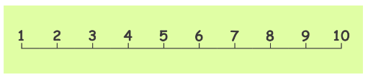



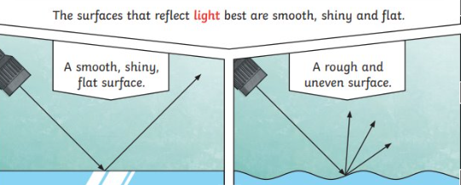
Ellwood Community Primary School – Core Subject Overview Year 3 – Autumn -Term 1
English | Maths | Science
Using the text ‘The Stone Age Boy’ to explore a character through drama, create a diary entry and write descriptions. They will also; plan, write and edit a story by considering the different viewpoints of others. |  | Light They will learn about different sources of light, and that we need light to see. The children will work scientifically and collaboratively to investigate reflective materials, in the context of designing a new book bag. They will work in a hands on way to play a range of mirror games, finding out more about reflective surfaces. Furthermore, they will learn that the sun’s light can be dangerous, and will create an advert for a pair of sunglasses or a sun hat that they have designed. The children will have chance to test which objects are opaque in an exciting investigation to design the most effective curtains, and will find out how shadows change when the distance between the object and light source changes. They will develop their scientific enquiry skills, making observations, predictions and conclusions.
Place Value:
count from 0 in multiples of 4, 8, 50 and 100;
find 10 or 100 more or less than a given number
recognise the place value of each digit in a 3-digit number (100s, 10s, 1s)
compare and order numbers up to 1,000
identify, represent and estimate numbers using different representations
read and write numbers up to 1,000 in numerals and in words
solve number problems and practical problems involving these ideas
Addition and Subtraction:
Add and subtract numbers mentally, including:
a three-digit number and 1s
a three-digit number and 10s
a three-digit number and 100s
add and subtract numbers with up to 3 digits, using formal written methods of columnar addition and subtraction
estimate the answer to a calculation and use inverse operations to check answers
solve problems, including missing number problems, using number facts, place value, and more complex addition and subtraction
Grammar, Punctuation and Spelling
Recap the main word classes
Revise expanded noun phrases
Conjunctions
Subordinating conjunctions
Full stops, exclamation marks and question marks
Direct Speech
Inverted Commas
Prefixes
Suffixes

Slide 2

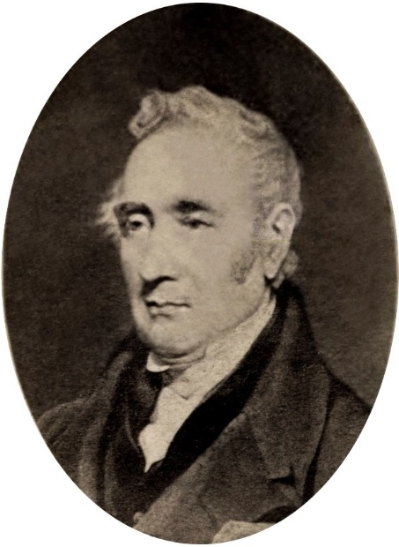
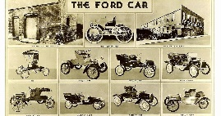

Ellwood Community Primary School – Specific Subject Overview Beech Class –Autumn 1
Computing Year 3- Differentiate between fact, opinion and belief online. Explain how to deal with upsetting online content.Recognise that digital devices communicate with each other to share personal information. Explain what social media platforms are used for. Recognise why social media platforms are age-restricted. Year 2- Explain what is meant by online information. Recognise what information is safe to be shared online. Explain why we need passwords and what makes a strong password. Understand that they need to ask permission before sharing content online and explain why. Understand that they have the right to deny their permission to information about them being shared online. Say who they can ask for help with online worries. Use some strategies to work out if online information is reliable or not. | Life Skills This half term we will be completing the ‘Oak’s Challenge.’ During this we will explore the 5 different ways of wellbeing. Then, the pupils will have 4 weeks to carry out the challenge and you will reflect on the outcomes in the last PSHE lesson of the term. | DT Cooking and eating seasonally: Children will be able to: Explain that fruits and vegetables grow in different countries based on their climates. Understand that seasonal fruits and vegetables grow in a given season. Understand that eating seasonal fruit and vegetables positively affects the environment. Design a tart recipe using seasonal ingredients.
 | History – Transport In this unit the children we exploring a range of different transport and understanding their purpose. We will be learning about two famous individuals; George Stephenson and Henry Ford and mapping out their achievements on a timeline. We will be visiting the Forest of Dean Railway and writing a newspaper report about the impact of the Steam trains both locally and nationally. We will also study cars and how they have developed and changed. At the end of this unit you will be invited to come and view our predictions upon the transport of the future.
RE We will be exploring the following questions: What do people believe about God? What is it like for someone to follow God? | Music Ballads: Identify the key features of a ballad. Perform a ballad using actions. Sing in time and in tune with a song and incorporate actions. Retell a summary of an animation’s story. Write a verse with rhyming words which tell part of a story. Perform their lyrics fluently and with actions. | PE In this unit pupils will develop the fundamental skills of balancing, running, jumping, hopping and skipping. Pupils will develop their ability to change direction with balance and control. They will be given the opportunity to explore how the body moves at different speeds as well as how to speed up and slow down. Beech Class, will be given the opportunity to work on their own and with others, taking turns and sharing ideas.

