Slide 1

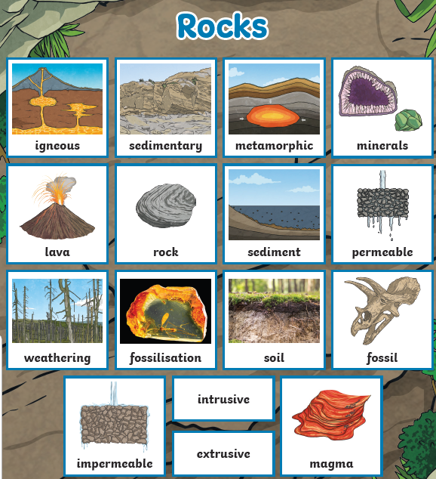
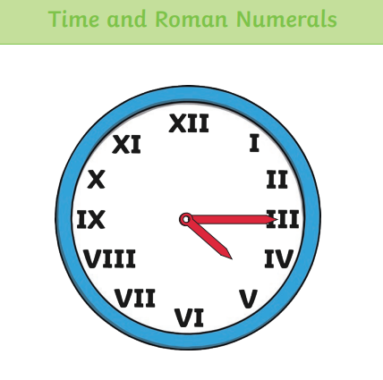
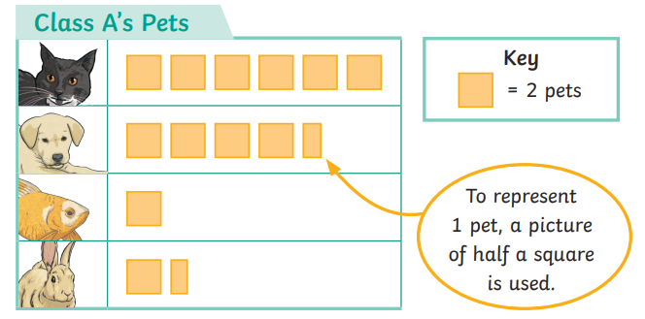
Ellwood Community Primary School – Core Subject Overview Year 3 – Summer Term 2
English | Maths | Science
Kensuke’s Kingdom During Summer Term Two, we will be continuing with our story Kensuke’s Kingdom. We will be writing about the main character’s (Michael) thoughts and feelings. We will be revising the use of apostrophes. Planning a story and writing a story. We will hold our own debate with answers for and against going on a trip around the world. We will write a newspaper article and publish this alongside our stories for you all to read and share. | Time Time is our main unit for this half term. In Year Three, the children develop their knowledge of time by learning about Roman numerals to 12, tell the time to 5 minutes and a minute. They will also learn in more details about minutes and seconds. Statistics In our topic of Statistics the children will learn to interpret a range of charts including bar and pictograms. By the end of this unit the children will be able to create their own pictograms and questions for their peers. | Rocks By the end of this unit this children will be able to: compare and group different types of rocks based on their appearance and simple physical properties explore how rocks change over time describe, in simple terms, how fossils are formed recognise that soils are made from rocks and organic matter

Slide 2
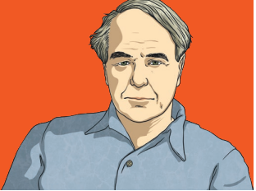
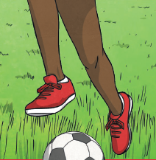
Ellwood Community Primary School – Specific Subject Overview Beech Class- Summer 2
Art We will be learning about the sculpture Henry Moore and what made him famous. Linking with our topic of Geography we will be making a sculpture out of clay based upon Gloucester Cathedral. We will also be sketching Gloucester Cathedral on our geography school trip. secondary colours, colour mixing techniques, and applying these skills in painting and p | Life Skills Aiming High This unit focuses on three main parts: Developing self-worth and focusing on things they have achieved Setting goals and working on how they can achieve this Viewing tasks with a positive learning attitude | Computing In Beech Class, we will be learning all about data handling. We gather data and place it into various diagrams include: carroll, venn and pictogram. Some children will also practise their touch typing skills by collected data and inputting it upon Excell.
 | Geography What city do we live in? In this unit we will be learning about what makes a capital city. We will be using a range of maps to find and compare Gloucester with Ellwood. We will also be completing some fieldwork in Gloucester and using a map to find ‘What makes a city?’ We will end our fieldwork at Gloucester Cathedral where we will have the opportunity to sketch and explore. At the end of this unit, the children will be given the chance to present what they have learnt to each other in Beech and Chestnut Class.
RE We will be learning about why some people think that life is a journey. They will learn about a Christian celebration of Baptism. They will then look at what happens in a Jewish bar Mitzvah. Next, they will relate this to how Hindus celebrate life. Finally, we will reflect upon what challenges people may face on the journey of life. | Music Beech Class will be learning about the music from the Great Composer Wolfgang Amadeus Mozart. They will learn a range of new vocabulary including: rondo, cadenza and coda. | PE In Physical Education in Summer 2, the children will be learning with Mr. Yearly all about Fitness. With Mrs. Woodhouse, they will be learning about Sportsmanship and preparing themselves for Sports Day.

