Slide 1



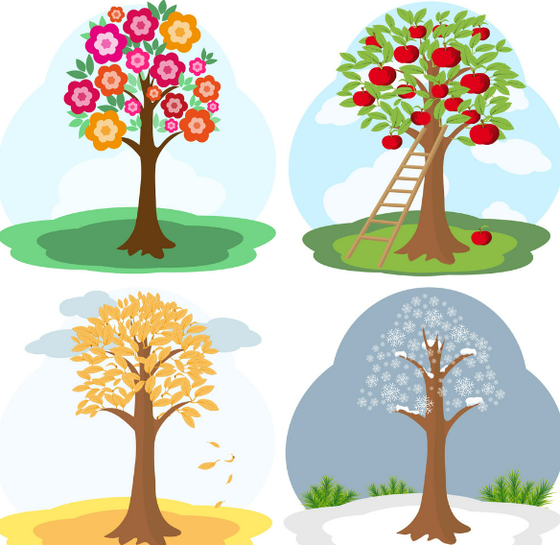
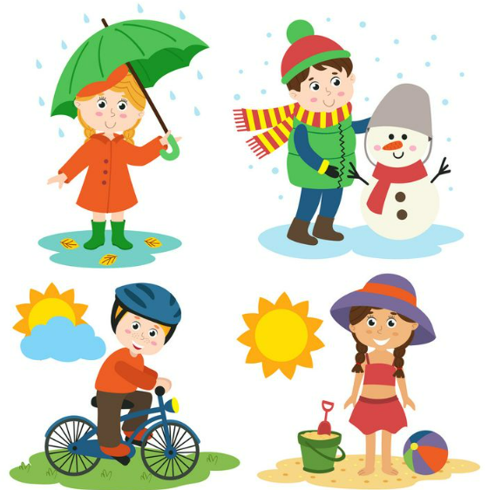

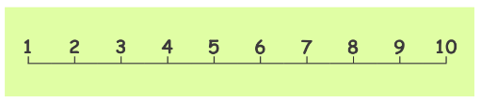
Ellwood Community Primary School – Core Subject Overview Year 1 – Autumn Term 2
English | Maths | Science
Poetry and Instructions This term we will use the book ‘Out and About’ by Shirley Hughes to create poems about the weather. We will focus on using our senses to describe the weather and use adjectives and verbs when writing our poems. We will then look at instructions and begin to write our own set of instructions using time adverbials and imperative verbs. | Addition and Subtraction Shape In our addition and subtraction unit we will learn how to write addition and subtraction number sentences. We will secure our knowledge of number bonds to 10. Children will recognise that the order of an addition sentence can be varied, and they begin to discover that addition is commutative. For example, 3 + 2 = 5 2 + 3 = 5 5 = 3 + 2 5 = 2 + 3 As children become more secure in reading and writing subtraction number sentences they will progress onto answering missing number problems. For example 10-_=6 In our shape unit, children will start by looking at 3-D shapes, identifying features and naming simple 3-D shapes such as cubes, cuboids, cylinders, pyramids, cones and spheres. | Seasonal Change In this unit children will find out about different seasons and how to describe them. We will use our senses during a walk around the school grounds looking for signs of Autumn. The children will observe how some plants change through the seasons. We will discuss how animals and humans are affected by the seasons.
Grammar, Punctuation and Spelling
The children will focus on using capital letters at the start of sentences, using finger spaces between words and punctuate sentences using a full stop.
We will begin to identify verbs, nouns and time adverbials during our English lessons.

Slide 2
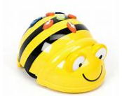
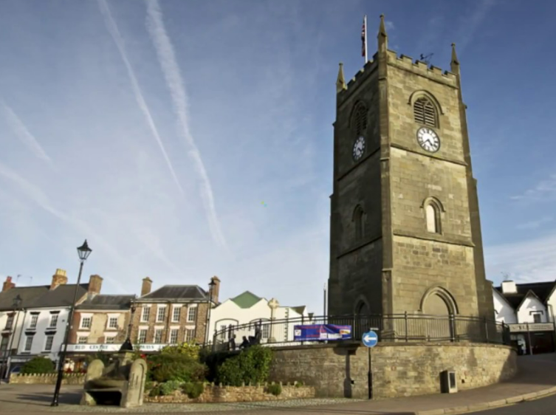
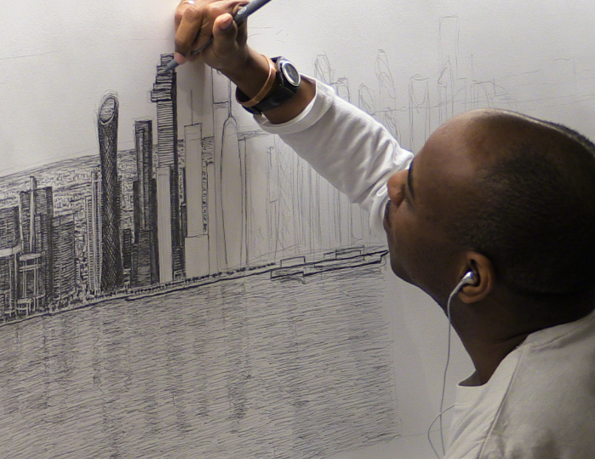




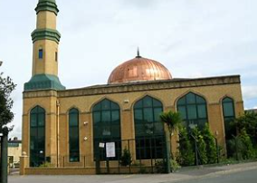


Ellwood Community Primary School – Specific Subject Overview Chestnut Class – Autumn Term 2
Art This term we are focusing on our drawing skills. We will learn how to sketch shapes, create tones and textures with a range of media. The children will learn about the artist, Stephen Wiltshire and create artwork in a similar style. | Life Skills ‘Be yourself’ In this unit children will recognise their positive qualities and appreciate their individuality. Children will recognise different emotions and explore different strategies to help them manage any uncomfortable feelings they experience. | Computing Year 1 – Exploring a Bee-Bot device and making predictions about what it might do, building up to trying out the buttons, then explaining the outcomes. Year 2 – In this unit children will learn how to deconstruct a game to predict the algorithms that are used. Understand what abstraction is and create their own map of the classroom. To find out what debugging is.
 | Geography Where is my school? In this unit of work children will begin to think about the school address and understand what happens to letters once they have been posted. Year 1 children will identify key features using aerial photographs whilst Year 2 will look at OS maps. We plan to visit Coleford to identify human and physical features. Children will then identify similarities and differences between Ellwood and Coleford.
RE We will explore the question ‘Who are Muslims and how do they live?’ | Music Our unit this term is ‘Pulse and Rhythm (Theme: All about me)’ The children will learn how to clap the rhythm of their name, in time to music and play simple rhythms using instruments. | PE In this unit children will explore travelling actions, movement skills and balancing. They will understand why it is important to count to music and use this in their dances. Pupils will copy and repeat actions linking them together to make short dance phrases. Pupils will work individually and with a partner to create ideas in relation to the theme. Pupils will be given the opportunity to perform and also to provide feedback, beginning to use dance terminology to do so.

