Slide 1

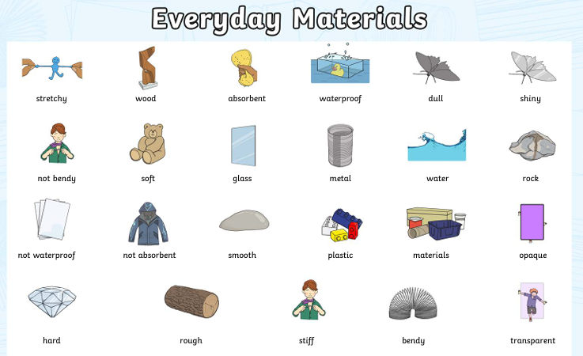
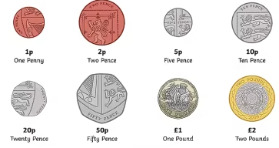
Ellwood Community Primary School – Core Subject Overview Year 2, Autumn Term 2
English | Maths | Science
English Units: We will use the quality text ‘The Owl who was Afraid of the Dark’. The children will be writing diary entries from Plop (the young owl) and then poetry inspired by the book. Spellings: Grammar: We will continue learning about adjectives, adverbs, verbs, conjunctions and nouns. | Addition and Subtraction Add and subtract numbers using concrete objects, pictorial representations, and mentally, including: a two-digit number and ones; a two-digit number and tens; two two-digit numbers; adding three one-digit numbers. Show that the addition of two numbers can be done in any order (commutative) and subtraction of one number from another cannot. Money We will be learning to recognise and use symbols for pounds (£) and pence (p); combine amounts to make a particular value. Find different combinations of coins that equal the same amounts of money. Solve simple problems in a practical context involving addition and subtraction of money of the same unit, including giving change | Materials Uses of Everyday Materials unit will explore the uses of everyday materials including wood, plastic, metal, glass, brick, paper and cardboard. Children will go on to compare the suitability of different everyday materials for different purposes. They will explore how objects made of some everyday materials can change shape and how the same material can be changed in different ways, depending on its structure and purpose. The children will carry out simple experiments, predicting the outcomes and then testing their hypothesises. We will sorting and classifying materials and objects in different ways, based on their properties and purpose.
This term we will learn ‘le’ and ‘el’ saying /l/, adding the suffixes ‘-er’ and ‘-est’ to words ending ‘y’, ‘al’ and ‘il’ saying /l/, adding the suffixes ‘-ed’ and ‘-er’ to words ending ‘e’ and the ‘eer’ saying /ear/.

