Slide 1
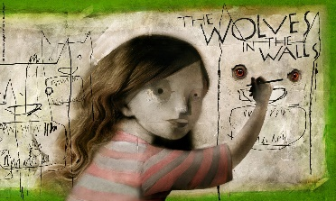
Ellwood Community Primary School Sycamore Class
Computing In computing, we are learning about E-Safety and how to keep ourselves safe online. We will be focusing on how to use the internet to communicate with others in an appropriate and safe manner. | Life Skills We are learning about the world of microbes and antibiotics. We will be focusing on infection prevention and control, importance of using antibiotics responsibly and empowering ourselves to look after our own health. | P.E. Sycamore will be focusing on Netball this term. They will be familiarising themselves with the key techniques, rules and tactics to play the game.
Mathematics In maths this term we are going to learn about the following concepts: Representing numbers to 10,000 Finding 1, 10, 100 and 1000 more or less than a given number Estimating numbers on a number line Comparing and ordering numbers up up to 10,000 Rounding numbers to the nearest 1, 10, 100 and 1000. Representing numbers up to 100 in Roman Numerals | Autumn Term 1 | English In literacy this term we are focusing on the story ‘The Wolves in the Walls’ by Neil Gaiman. We will be exploring how the author creates tension and look to create our own spooky stories.
History We are going to learn about the Roman Empire. We will be focusing on who the Romans were and how they built an empire. We are also learning in depth from different religious and spiritual ways of life regarding diverse beliefs about God. | Design and Technology In Design and Technology, we will be looking biscuits and how different ingredients can alter the aesthetic, taste and texture of food. We will be learning about cross contamination and how to keep ourselves safe when baking. | French In French, we will be learning how to say and write items of clothing.

