Slide 1


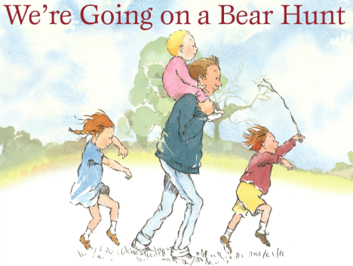
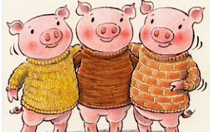

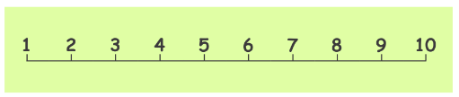
Ellwood Community Primary School – Core Subject Overview Year 1 – Autumn Term 1
English | Maths | Science
Going on Bear Hunt and Three Little Pigs This term we will retell the story of we are Going on a Bear Hunt and the Three Little Pigs using actions. The children will create story maps, describe characters and write their own stories. | Place Value Addition and Subtraction We will be learning how to sort objects in different ways, counting and represent objects. We will read, write and spell numbers as words. The children will identify 1 more and 1 less using number lines. In our addition and subtraction unit we will learn how to write addition and subtraction number sentences. We will secure our knowledge of number bonds to 10. | Materials and Seasonal Change In this unit, children will identify and name common types of materials including wood, metal, plastic, rubber, fur, wool, sponge, cotton wool, paper, card, brick, rock and some liquids. We will label, collect and group together objects made from the same material. The children will state that different objects can be manufactured from the same materials. They will say why some materials are unsuitable for some objects. Working scientifically, children will test the properties of different liquids. They will have investigated which materials are good to wrap and protect an egg being dropped from a height.
Grammar, Punctuation and Spelling
The children will focus on using capital letters at the start of sentences, using finger spaces between words and punctuate sentences using a full stop.
In Phonics we will revise Level 1+ to Level 3 sounds in the first few weeks and then we will move onto Level 4 sounds.

Slide 2

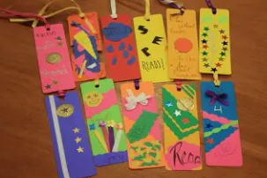
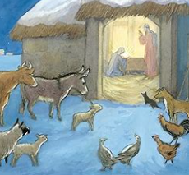

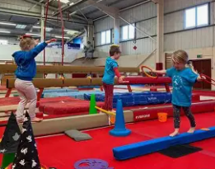
Ellwood Community Primary School – Specific Subject Overview Chestnut Class – Autumn Term 2
DT In Design Technology this term the children will be designing and creating their own bookmarks. They will plan and practise the skills needed to create a bookmark. Year One and Two will both complete a design booklet to support their planning process. Year Twos will begin to use the running stitch. | Life Skills In this unit of TEAMS, we will discuss the importance of Team Work. The children will learn about how working together they can achieve more. Chestnut Class, will learn about being a good listener and about the importance of being kind to one another. The children will be able to explain about what is a positive learner. They will also be able to identify what is a good and a bad choice. | Computing The children will learn about using word processor. By the end of this unit the children will be able to; use a mouse accurately to navigate a computer, type in a word document using the correct keys. At the end of this unit the children will receive the opportunity to demonstrate their new skills using sketch pad.
 | Geography Where do I live? In this unit of work children will begin to think about where they live and being able to recall the four countries that make up the United Kingdom and the capital cities. Year 2 children will begin to locate the 7 continents.
RE This term we will be thinking about the question: Why does Christmas matter to Christians and why do they celebrate it? | Music This term the children will be getting into character ready for our Christmas Nativity of Lights, Camel Action. We will be learning the songs and putting a glittery performance together for you! | PE This term, Chestnut Class are fortunate to have specialist teacher teach them on a Wednesday for Cricket by a Cricket Coach and on a Thursday for Gymnastics at the Forest of Dean Gymnastics Centre.

