Slide 1
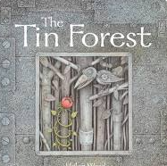

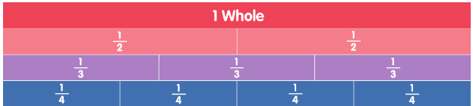

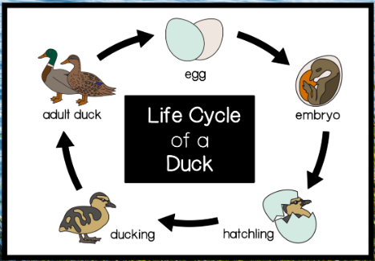
Ellwood Community Primary School – Core Subject Overview Spring Term 2 2026, Year 2
English | Maths | Science
English Units: We will be focusing our English unit on, ‘Tin Forest’ and work towards the final outcome of letters. We will then move onto ‘Nen and the lonely fisherman’. We will exploring the rich vocabulary in the book, making comparisions to other known stories and finally writing our own character and setting descriptions. Spellings: This term we will learn ‘o’ saying /u/u, ;ey; saying /ee/, adding –er, -est and –y to CVC and CVCC words, contractions, ‘war’ saying /wor/ and ‘wor’ saying /wur/, Adding suffixes –ment and –ness to words and ‘s’ saying /zh/. Grammar: We will be recognising plural or possession for the use of apostrophes, using exclamations, recognizing statements, using statements and using apostrophes for contractions. | Fractions Recognise, find, name and write fractions 1/2, 1/4 , 2/4, 1/3 and 3/4 of a length, shape, set of objects or quantity Write simple fractions [e.g. 1/2 of 6 = 3] and recognise the equivalence of 2/4 and 1/2. Time Compare and sequence intervals of time. Tell the time; including quarter past/to the hour, o’clock and half past. Draw the hands on a clock face to show these times. Tell and write the time to 5 minute intervals. Know the number of minutes in an hour and the number of hours in a day | Animals including humans This term the children will identify and match animals offspring and their adult forms before moving on to describing the main characteristics of the offspring found in different animal groups. They will learn about the life cycles of different animals. The children will identify how humans grow. They will also identify the basic needs that animals have in order to survive. We will finish the science unit by looking at the importance of exercise and the effect it has on the body before finishing out about different food groups and the role they play in our diet.

