Slide 1
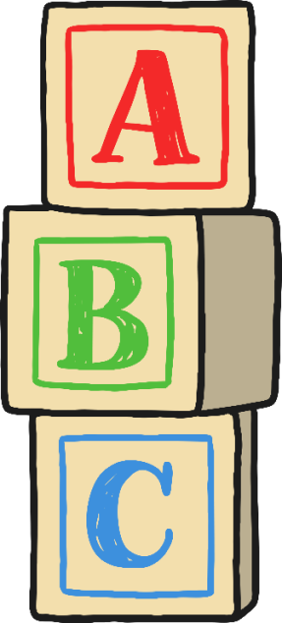
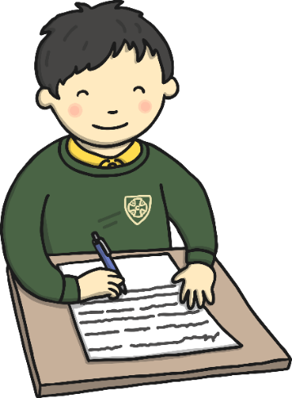
Teaching Phonics in Reception
Ellwood Community Primary School

Slide 2
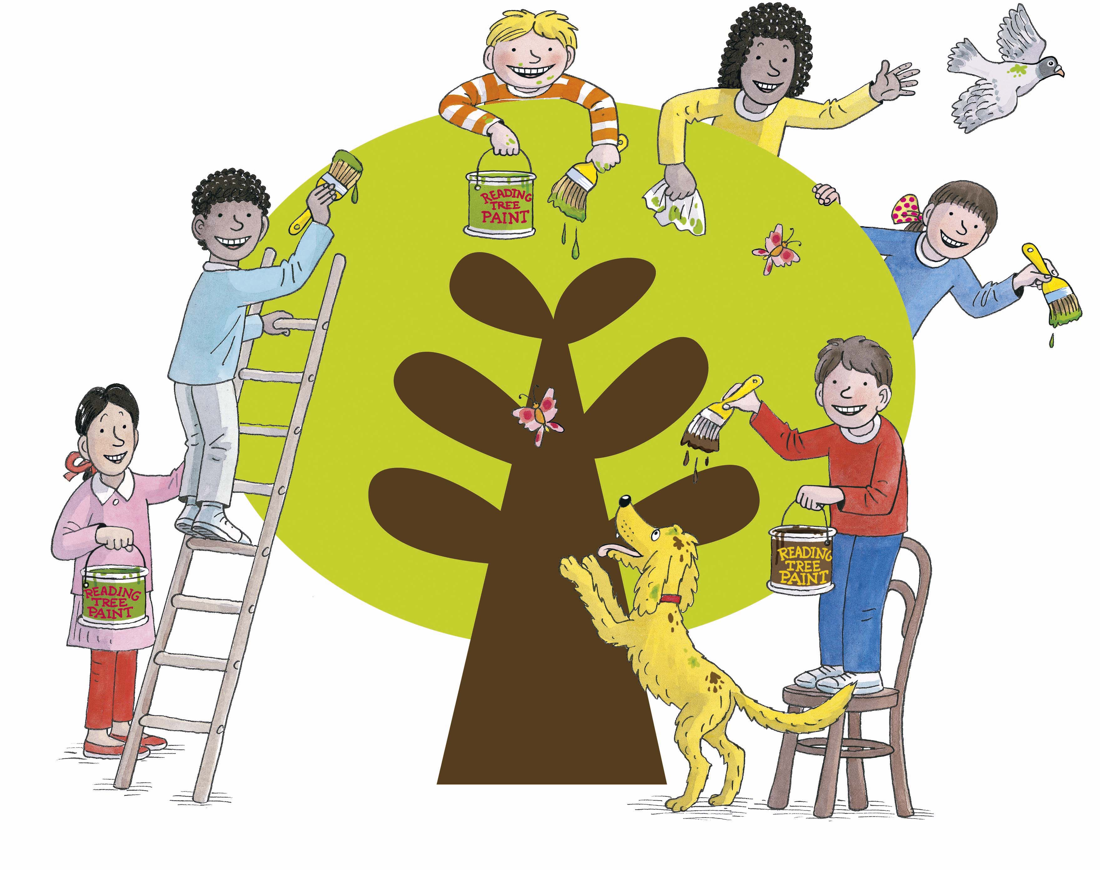
What is Phonics?
Phonics is a method of teaching children to read and write.
At Ellwood School we follow the ‘Floppy’s Phonics’ programme which is divided into levels.
https://www.oxfordowl.co.uk/for-home/reading/phonics-made-easy/

Slide 3
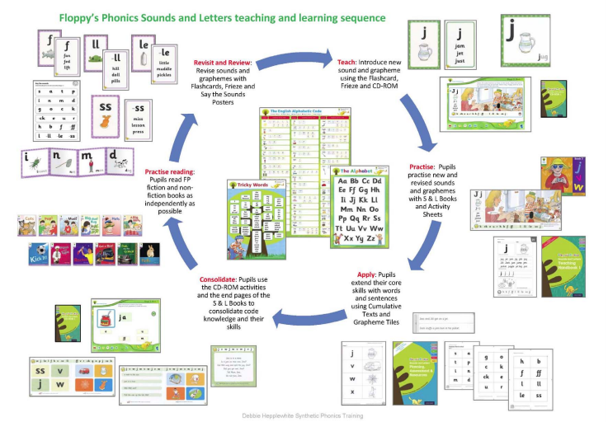

Slide 4
Pronouncing the sounds:
It is important that children learn the letters and the sounds.
(focus on the sounds for reading/writing)
Please ensure your child is pronouncing the sounds correctly as incorrect pronunciation will affect your child’s ability to read.
Notes:
In phonics teaching we focus upon the sound the letter makes particularly in Early Years to avoid confusion.

Slide 5
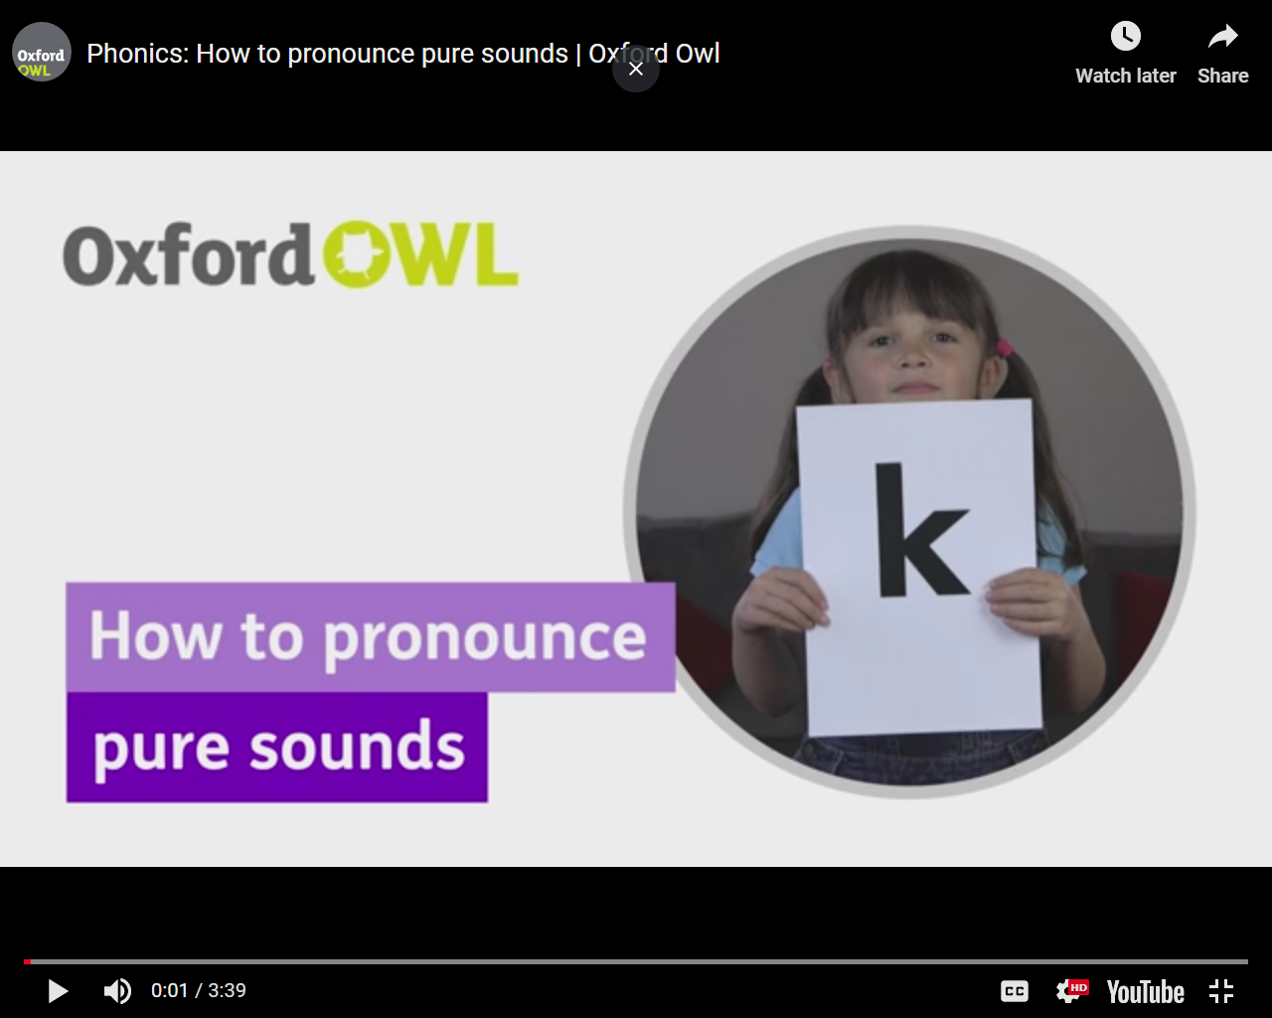
Sound pronunciation
For help with pronunciation:
https://www.youtube.com/watch?v=UCI2mu7URBc

Slide 6
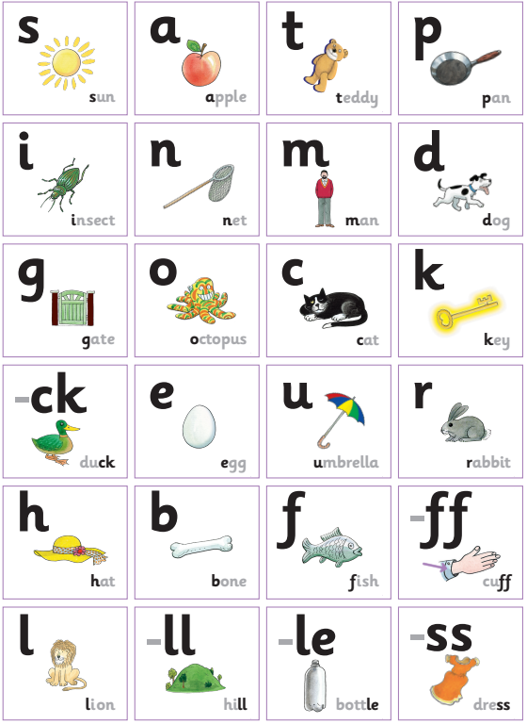
Level 1+

Slide 7
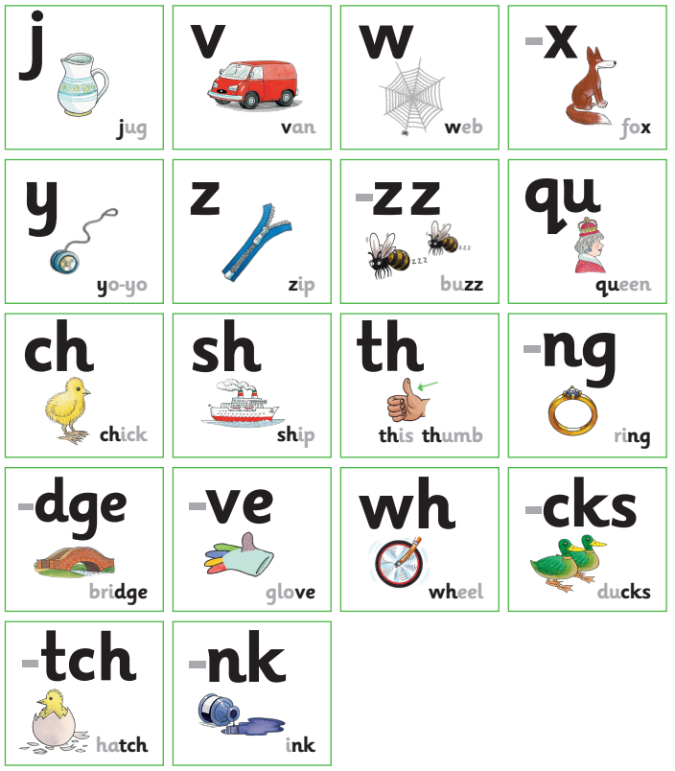
Level 2
Most of these feature two letters, known as digraphs. These have two letters but make one sound.

Slide 8
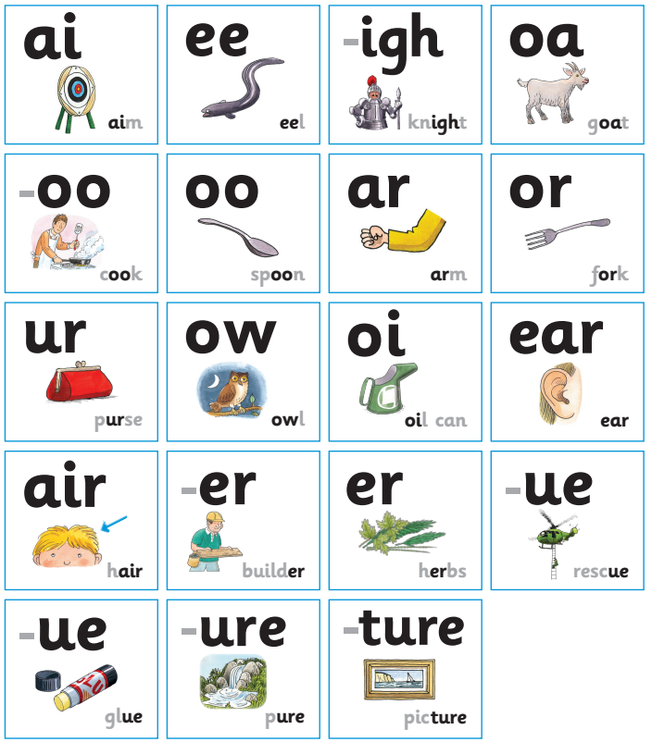
Level 3
We aim to ensure every child is secure in phase 3 by the end of reception.

Slide 9

Blending
We are teaching the children to blend sounds together to read words:
p – i – n
becomes pin
This can be tricky initially – keep modelling this skill to your child.

Slide 10
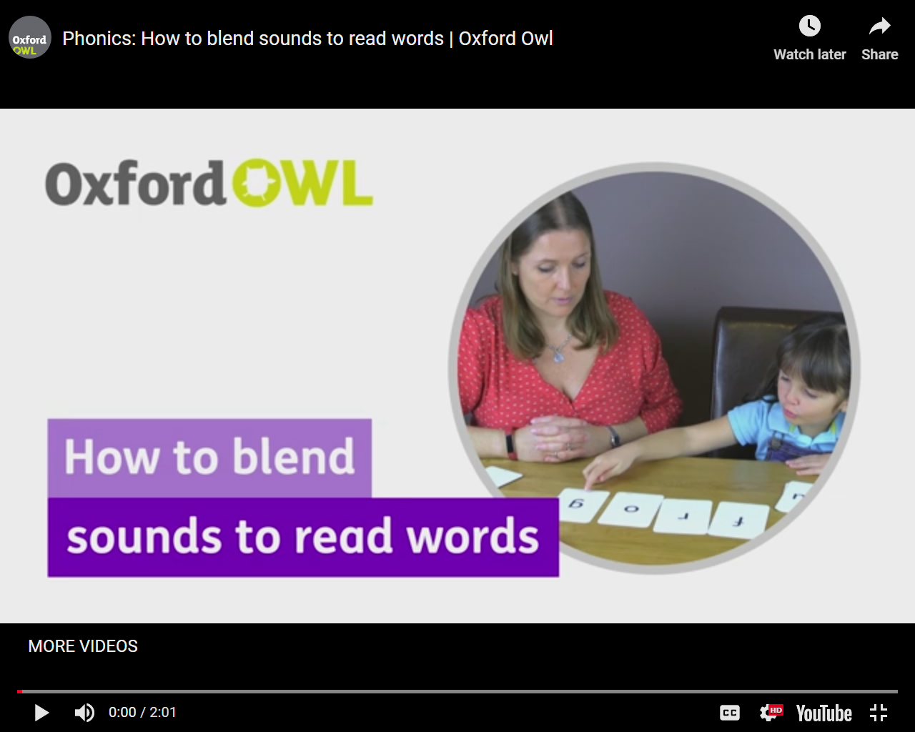
Blending video
https://home.oxfordowl.co.uk/at-school/education-glossary/grammar-literacy-glossary-a-c/#blending

Slide 11
Segmenting
sat becomes
s – a – t
This is the skill required for writing.

Slide 12
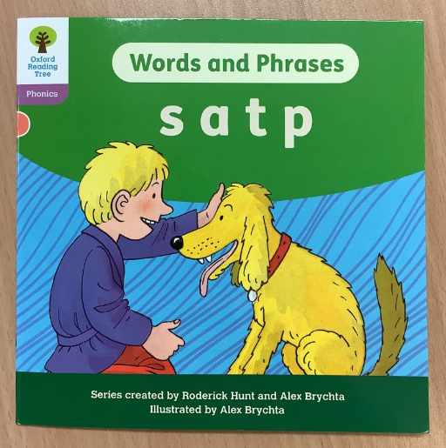
Floppy’s Phonics Books
Each child will be given a phonics book to read weekly.
These books will match the sounds which have been taught in school that week.
All children need to read the book regularly at home to reinforce sound knowledge.
These books will be changed weekly (every Friday).

Slide 13
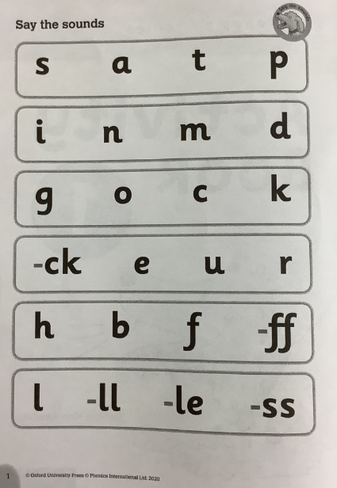
Phonics Sounds
Children will be given sound sheets to practise their phonic sounds at home.
Your child can practise pointing to each individual letter and then saying the sound.
These sounds need to be revised at home – please do this as regularly as you can.

Slide 14
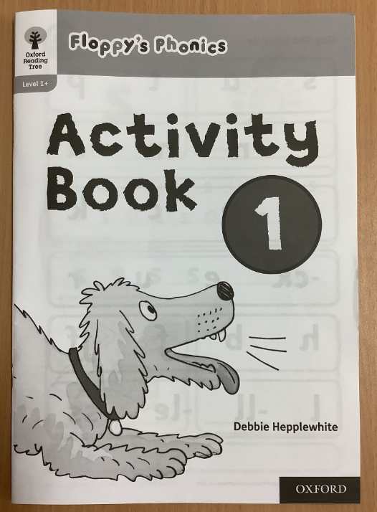
Phonics Homework – Activity Book
This is your child’s phonics homework.
Each week they will be set a double sided sheet to complete.
Each sheet needs to be completed with adult support to model letter formation.

Slide 15
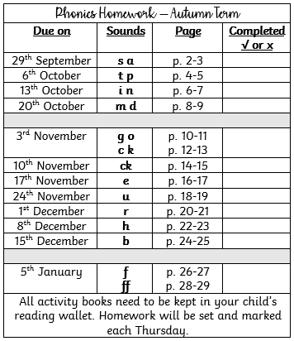
Phonics Homework – Activity Book
Please see the sticker on the back of the book for information about when each sheet needs to be completed.

Slide 16
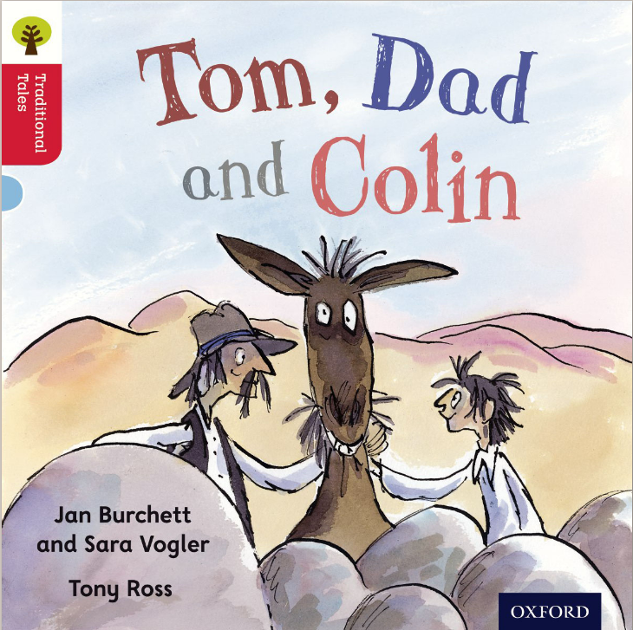

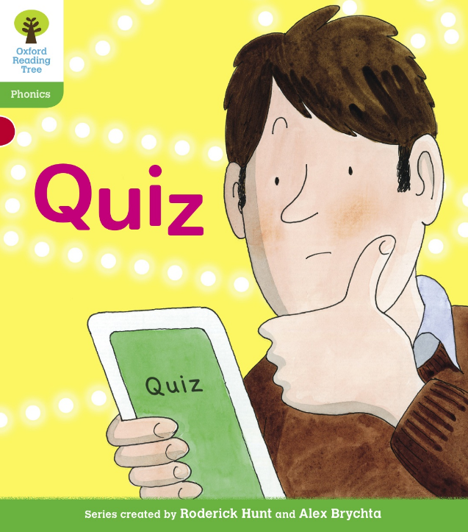
Levelled Reading Book
Children will also have a levelled reading book linked to their reading attainment (see reading tracker in front of reading record).
Reading Expectations
Autumn Term 2: Level 1+
Spring Term 2: Level 2
Summer Term 2: Level 3/4

Slide 17
Helpful Words
Each phase of phonics requires the children to learn a set of helpful words:
Helpful words cannot be sounded out – children must learn them from sight.
Level 1 | Level 2 | Level 3 | Level 4 | Level 5
The the to I no go into of ten little | he she me we was you they all are her off when six seven have | be are my too why sky look again sister | said like so do some come were there out what mother brother one three looked | their people called asked could oh no should would because here our father who where which four five eight nine try cry ball small call asked liked two goes does shoes

Slide 18
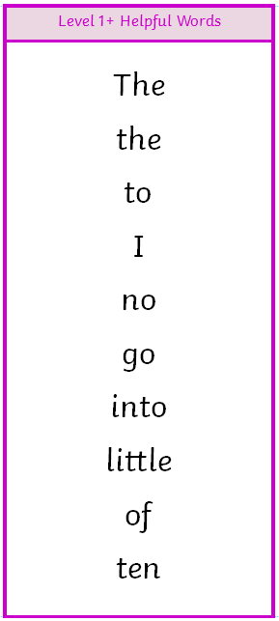
Helpful Word Bookmarks
Your child will have a ‘Helpful Word’ bookmark attached to the front of their reading record. Please practise reading the words regularly.
Children need to learn how to read and spell these words with confidence.
When your child can read and write the words they will be given a new set of words.

Slide 19
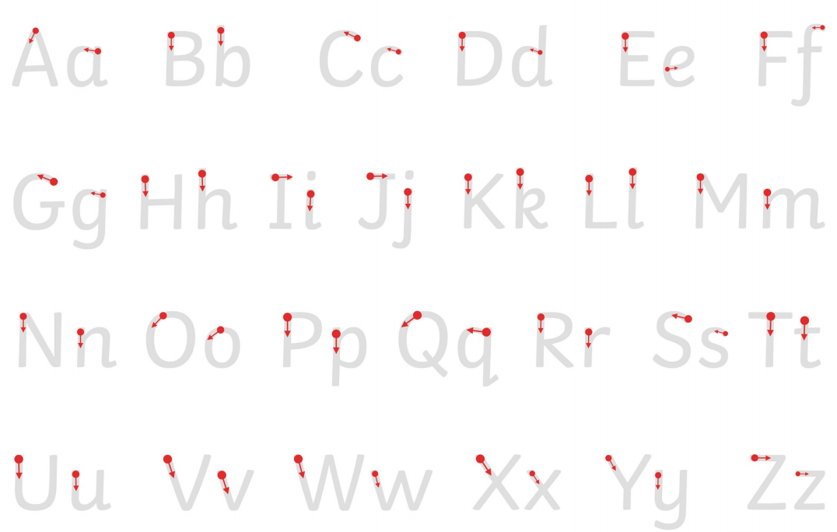
Letter Formation

Slide 20



How to support your child:
Play rhyming games/read rhyming stories.
Sing songs, nursery rhymes, story telling.
Read regularly with your child (if you want your child to read to you – make sure they are not tired).
Spot letters/sounds everywhere you go (anything that interests your child – ask them to identify sounds they can see out and about).

Slide 21
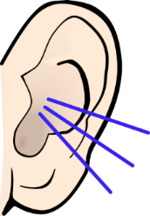
How to support your child:
Encourage your child to listen to environmental sounds they hear.
Model blending and segmenting words.
Practise reading and writing the helpful words.
Practise recognising sounds in your child’s activity book.
Practice blending skills using your child’s ‘Floppy’s Phonics Book’
Please speak to Mrs King at any time if you have any questions/concerns.

Slide 22
Phonic Glossary
Your child will be taught these terms:
Blending: blending the sounds together to read a word.
Segmenting: identifying the sounds which make up a word.
Digraph: one sound – two letters.
Trigraph: one sound – three letters.
Sound buttons: individual sounds in words.
Tricky words/ helpful words: words that cannot be sounded out.

