Slide 1
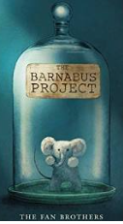
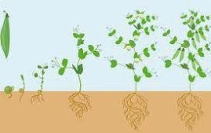
Ellwood Community Primary School – Core Subject Overview Year 2
English | Maths | Science
English Units: We will be focusing our English unit on ‘The Barnabus Project’. This will lead into our own non-fiction reports about failed projects they create. Grammar: We will be recognizing and using compound nouns, suffixes ‘-ment’, ‘-ness’, ‘-ly’ and ‘-ful’, comparative adjectives, superlative adjectives, upper and lower case, range of punctuation, noun and verbs. | Recap We will begin this term by recapping properties of shape and solving problems involving addition and subtraction. Statistics The children will interpret and construct simple pictograms, tally charts, block diagrams and simple tables. Ask and answer simple questions by counting the number of objects in each category and sorting the categories by quantity. Ask and answer questions about totalling and comparing categorical data. Measurement Choose and use appropriate standard units to estimate and measure length/height in any direction (m/cm); mass (kg/g); temperature (°C); capacity (litres/ml) to the nearest appropriate unit, using rulers, scales, thermometers and measuring vessels. Compare and order lengths, mass, volume/ capacity and record the results. | Plants In this unit children have the opportunity to closely study plants and trees in the natural environment, taking measurements and making observational drawings. Children plant a seed and a bulb and compare them as they grow. They record changes in their plants in words and pictures, take measurements throughout the unit and finally draw bar charts to show the growth of the two plants. Children set up a comparative experiment to observe what plants need to grow well, and watch the germination process first hand by growing cress. Children begin to learn about plants we eat, and understand that farming involves creating the right conditions for food crops to grow.
Spellings:
‘war’ saying /wor/ and ‘wor’ saying /wur/, adding suffixes –ment and –ness to words, ‘s’ saying /zh/, wa saying /wo/, qua saying /quo/
‘tion’ saying /shun/, adding the suffixes –ful, -less and –ly

