Slide 1
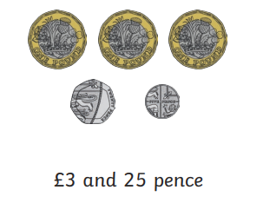
Ellwood Community Primary School – Core Subject Overview Year 3 – Summer Term 1
English | Maths | Science
Kensuke’s Kingdom During Summer Term, we will be reading all the story of Kensuke’s Kingdom by Michael Morpurgo. We will be building to write an adventure story. Along the way we will be using our oracey skills act our parts of the story and play the roles of the different characters to enrich our writing. We will build upon drafting our work. Year three will continue to use a range of punctuation such as parenthesis and inverted commas. They will also recap upon using paragraphs. We will also write Haikus during the last week of term. | Fractions In Maths, we will be continuing this term with our work upon Fractions. We will be adding and subtracting fraction with the same denominator. We will also be understanding equivalent fractions and comparing fractions using more than, less than and equal to symbols. Money In our unit of Money, we will be adding and subtracting money. We will also be identifying pounds and notes and converting these amounts. | Animals Including Humans In this unit, Year Three will learning about the nutrients that different foods provide and how these nutrients help our bodies. They will also explore how different animals eat different types of foods and need different proportions of nutrients. Year Three will learn to understand what food labels on packaging show and gather information from food labels to help them to answer questions. In this unit, the children will also explore the different types of skeletons that animals have and compare these. They will learn some names of bones in the human body and carry out an investigation to explore if people with longer femurs jump further. They will discuss how to plan a fair test and measure and record accurately. Year Three will also learn about how muscles help us to move and make a simple scientific model which they use to explain to a partner how skeletal muscles work.

Slide 2
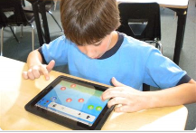
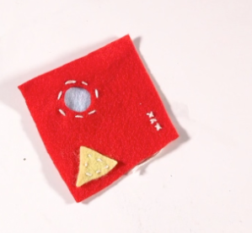
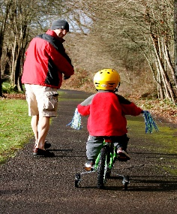
Ellwood Community Primary School – Specific Subject Overview Beech Class- Summer 1
DT In this unit of Design Technology, we will be making and designing cushions. Beech Class will learn how to sew using cross stitch and applique stitching patterns. They will decorate and evaluate their products. nit children learn about primary and secondary colours, colour mixing techniques, and applying these skills in painting and printing. | Life Skills This unit explores Money Matters. Children will discuss how we spend money, why people might need to borrow money and the consequences of this. Children will begin to explore how we can prioritise what we spend money on and what choices we have, including environmental considerations of wider spending. | Computing In Beech Class, we will be using the iPads to create stop motion book trailers based upon our literacy book Kensuke’s Kingdom.
 | History Stone-Age The children will learn about hunting and gathering in the Stone Age. They will look at and compare Stone Age to Bronze Age homes and clothing.
RE We will be learning about the different festivals that are celebrating in various religions such as Eid. We will be comparing and discussing these in regards to Christianity. | Music Beech Class will learning how to use their voices to sing different Viking songs. They will focus upon recognizing simple rhythmic notation by ear and sight. | PE In Physical Education in Summer 1, we will be learning many techniques involved with Athletics. The children will also receive biking lessons from Follow MY Lead on a Thursday.

